Slide 1

System Architectures
COMSM4111 Robotic Systems
Anonymous Feedback form:
https://forms.gle/PyQQy2mwzyATFmJW6
Padlet board (questions & comments):
http://padlet.com/paul_odowd1/1lhoodwv2fuc
Delivered by:
Paul O’Dowd paul.odowd@bristol.ac.uk

Slide 2
House Keeping
5-6pm, every day, Maps in MVB 1.11
Line Sensor Hook-up
Assessment Opportunity 1
Arrive for your booked slot.
You’ll be asked to zip/email your code to me paul.odowd@bristol.ac.uk
Looks like we’ll have between 3-5pm to provide taught support in Bill Browns with access to maps.
Group Declarations / Match-Making BB Threads
Deadline 6pm Friday 15th November

Slide 3
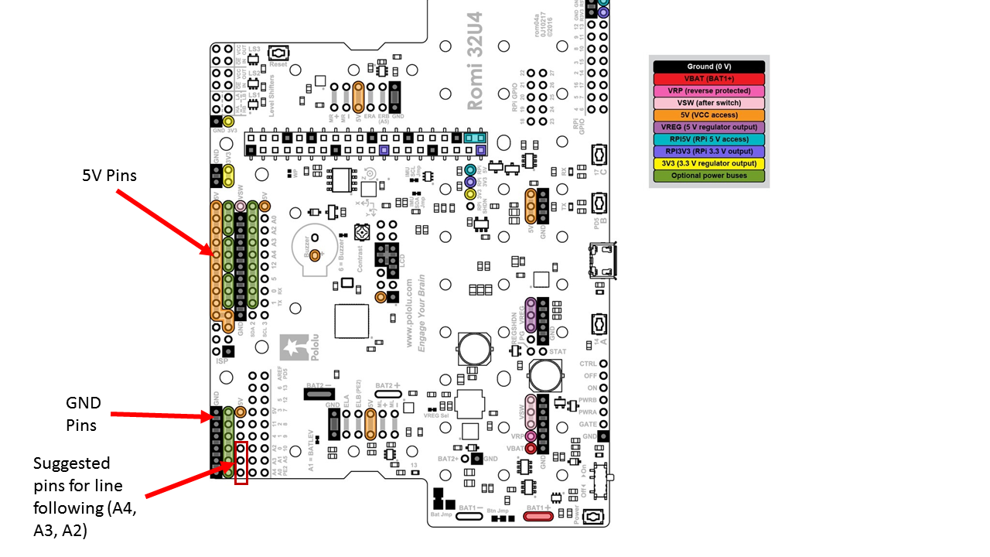
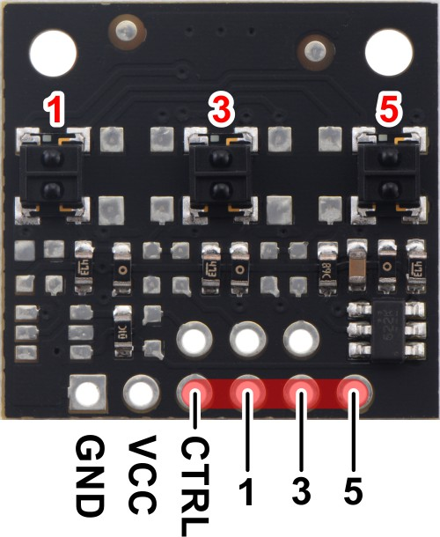
Line Sensor Hook-Up

Slide 4
Lab Sessions / Sheets
Week 1
Week 2
Week 3
Week 4
Week 5
Week 6
Week 7
Meet the Romi
Millis()
Encoders
PID
Line Following
Finite State Machine
Motors
Time & Speed
Kinematics
Lectures
Intro
Sensors & Actuators
Feedback Control 2
Probabilistic Robotics
System
Architectures
Path Planning
Experimental Robotics
Micro-controllers
Feedback Control 1
Kinematics
PID Drop-In
Sensor Fusion
Searching & Mapping
Toward
Assessment 2
Assessment Op 1
Assessment Op 2
Assessment Op 3

Slide 5
This Lecture:
Some Background
Automata
“Robots”
3 Architecture Paradigms
Hierarchical, Reactive, Hybrid
The Labsheets, Our Task
FSM Skeleton Code

Slide 6
Automata, 18th Century
https://www.youtube.com/watch?v=OehTO9l1Hp8

Slide 7
“Robots”
1550(?), Jewish Folklaw – Golem, an animated anthropomorphic being that is magically created entirely from inanimate matter (usually clay or mud).
1818, Frankenstein - written by English author Mary Shelley (1797–1851) that tells the story of Victor Frankenstein, a young scientist who creates a hideous sapient creature in an unorthodox scientific experiment.
1920, Rossum's Universal Robots - by Karel Čapek, The play begins in a factory that makes artificial people, called roboti (robots), from synthetic organic matter.

Slide 8
This Lecture:
Some Background
Automata
“Robots”
3 Architecture Paradigms
Hierarchical, Reactive, Hybrid
The Labsheets, Our Task
FSM Skeleton Code

Slide 9
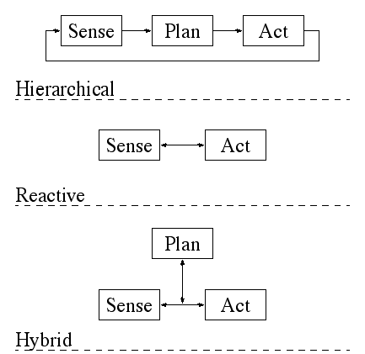
3 Architecture Paradigms
(deliberative)
(three layer architecture)
Notes:
http://cs.brown.edu/people/tdean/courses/cs148/02/architectures.html

Slide 10
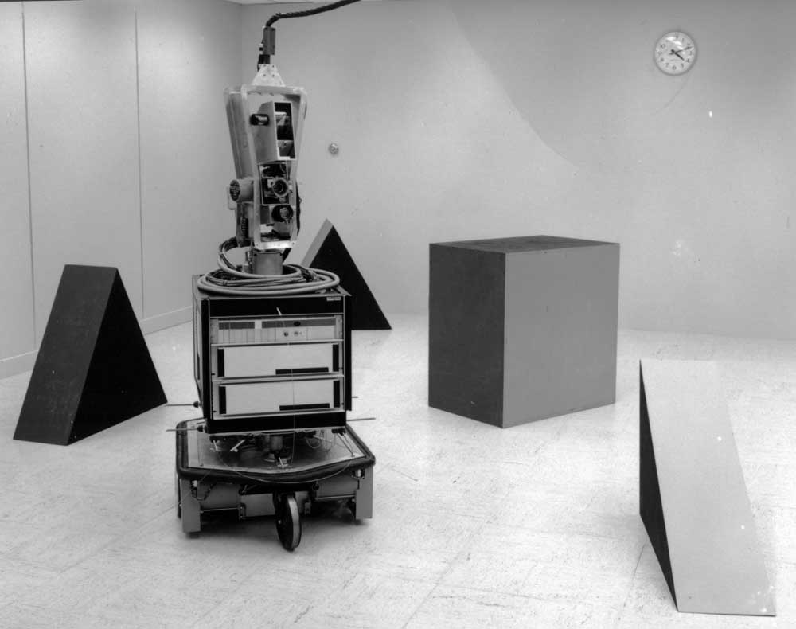
Shakey
Notes:
“Shakey”
http://www.ai.sri.com/shakey/images/5953f53_19670821_1000x790.jpg

Slide 11
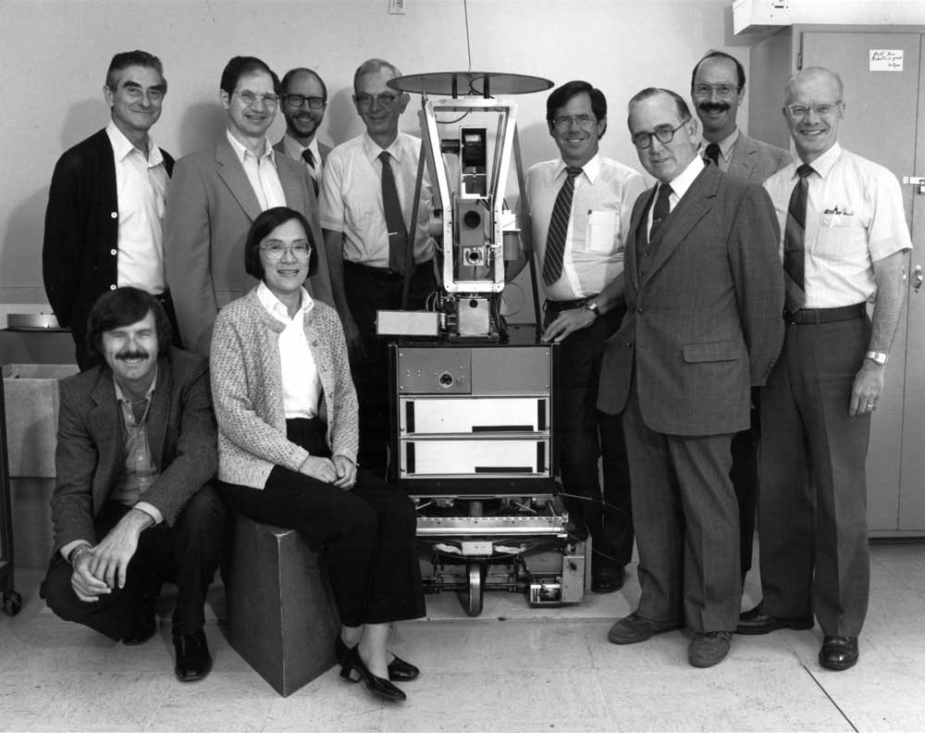
Notes:
http://www.ai.sri.com/shakey/images/8308182_12_1000x792.jpg
Back: Charles Rosen, Bertram Raphael, Dick Duda, Milt Adams, Gerald Gleason, Peter Hart, Jim Baer Front: Richard Fikes, Helen Wolf, Ted Brain

Slide 12
Video of Shakey
https://www.youtube.com/watch?v=7bsEN8mwUB8

Slide 13
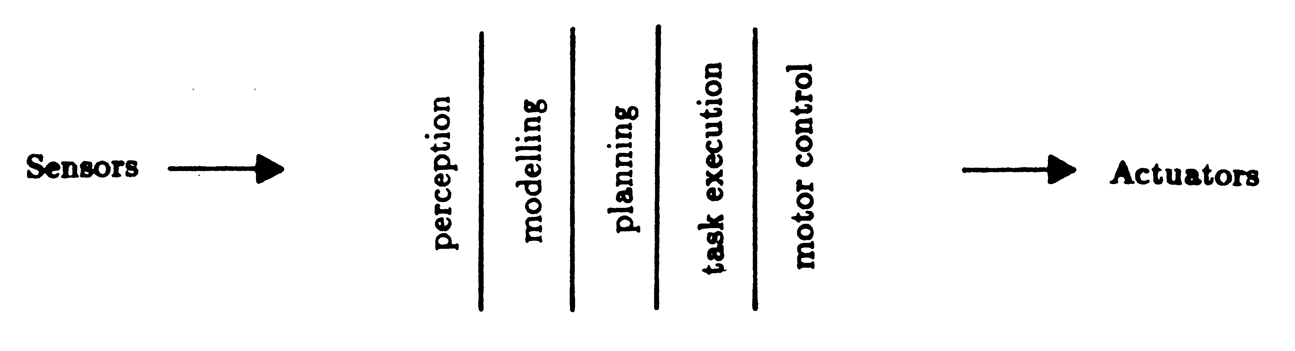
Hierarchical (Deliberative)
(Good Old Fashioned AI: the brain as a machine for processing symbols)

Slide 14
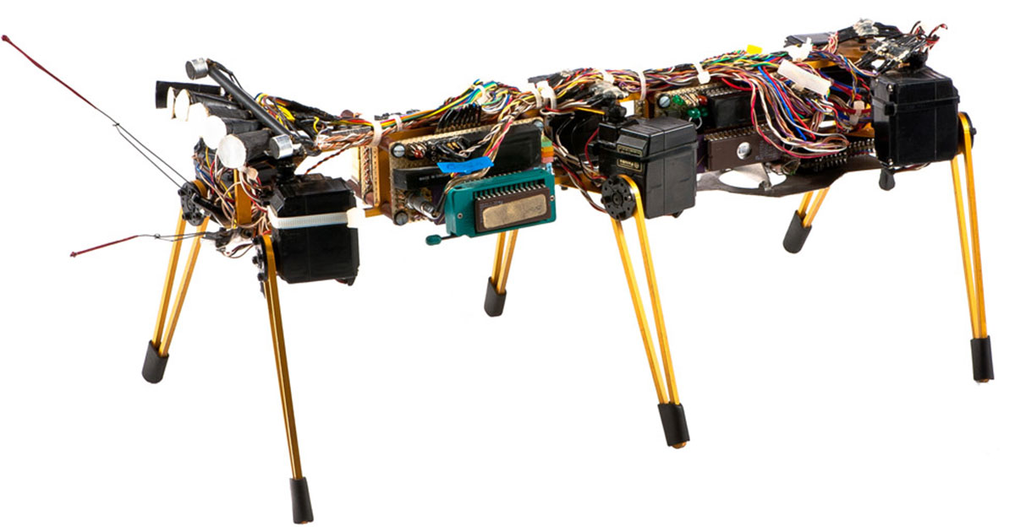
Genghis
Notes:
Video of Genghis
https://www.youtube.com/watch?v=BUxFfv9JimU

Slide 15
Video of Genghis
https://www.youtube.com/watch?v=RKeBl0-msGQ

Slide 16
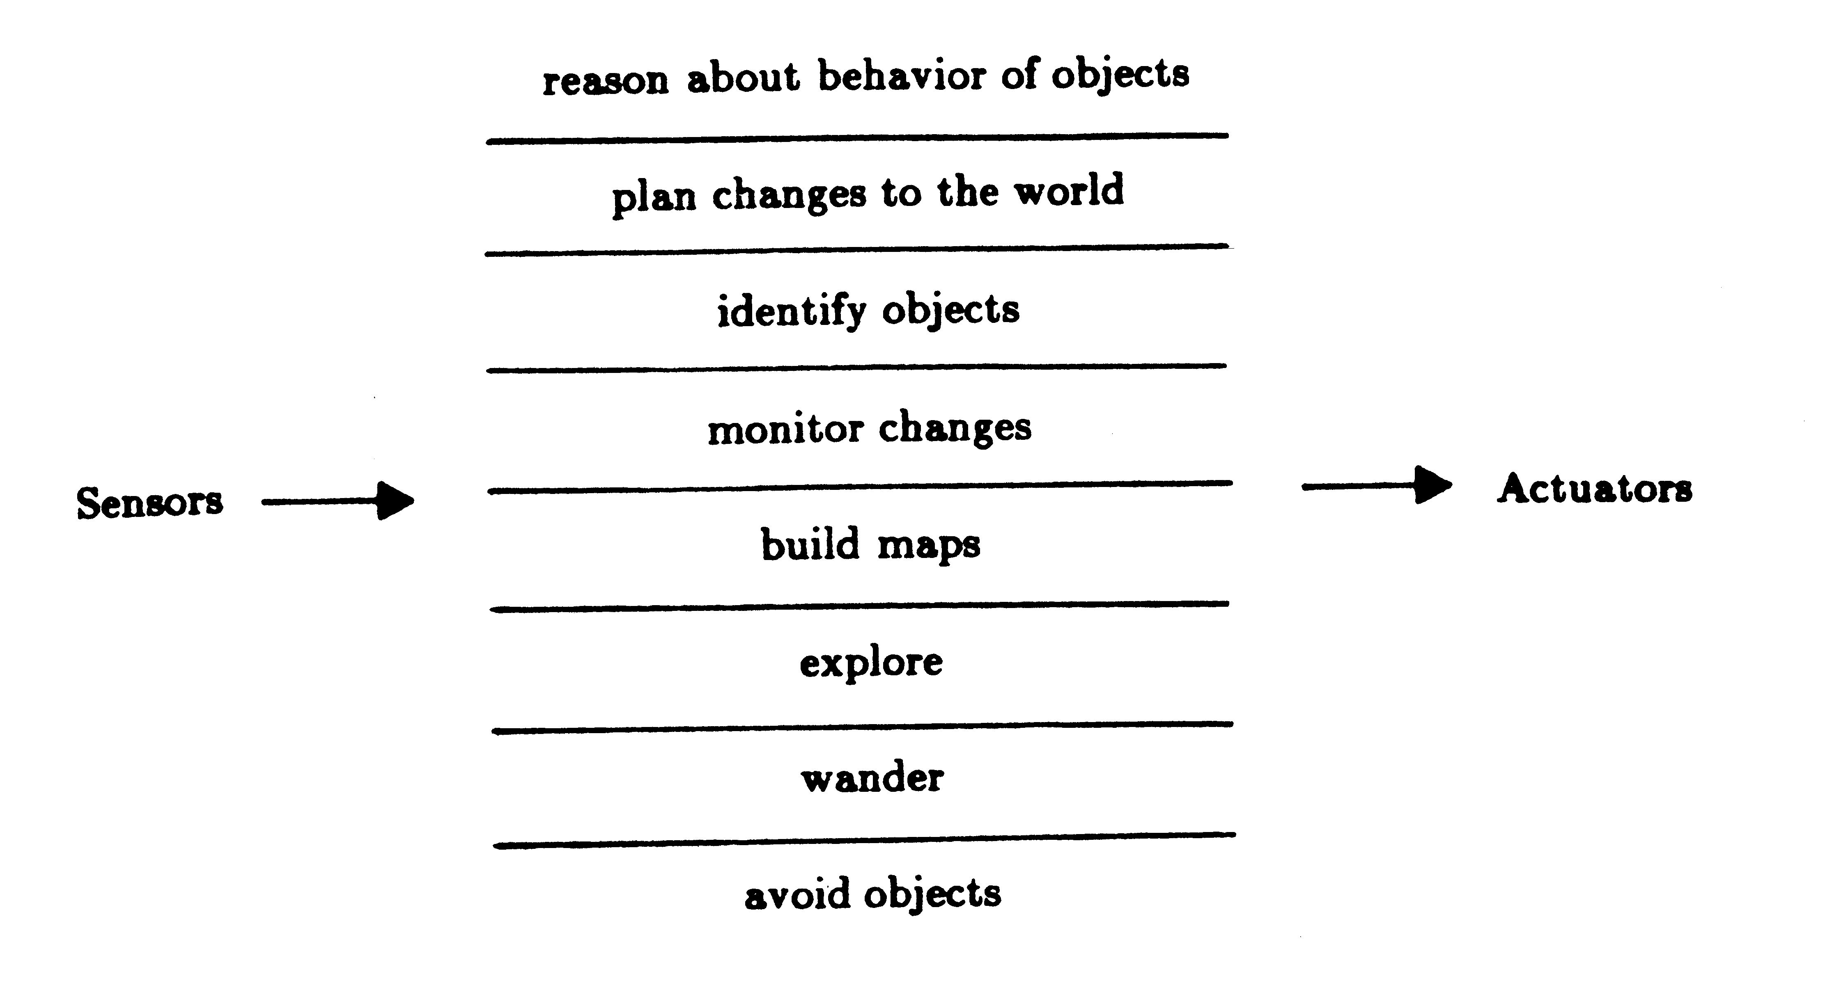
Reactive
(The world is its own best model: the start of a conversation on embodiment in robotics)
R. Brooks, "A robust layered control system for a mobile robot," in IEEE Journal on Robotics and Automation, vol. 2, no. 1, pp. 14-23, March 1986.
http://ieeexplore.ieee.org/stamp/stamp.jsp?tp=&arnumber=1087032&isnumber=23631
Notes:
“The world is its own best model.”
Very fast, responsive operation. Eliminated the sense-plan-act pauses.
Reactive systems have no world model. Instead their behaviour is tightly coupled to the environment.

Slide 17
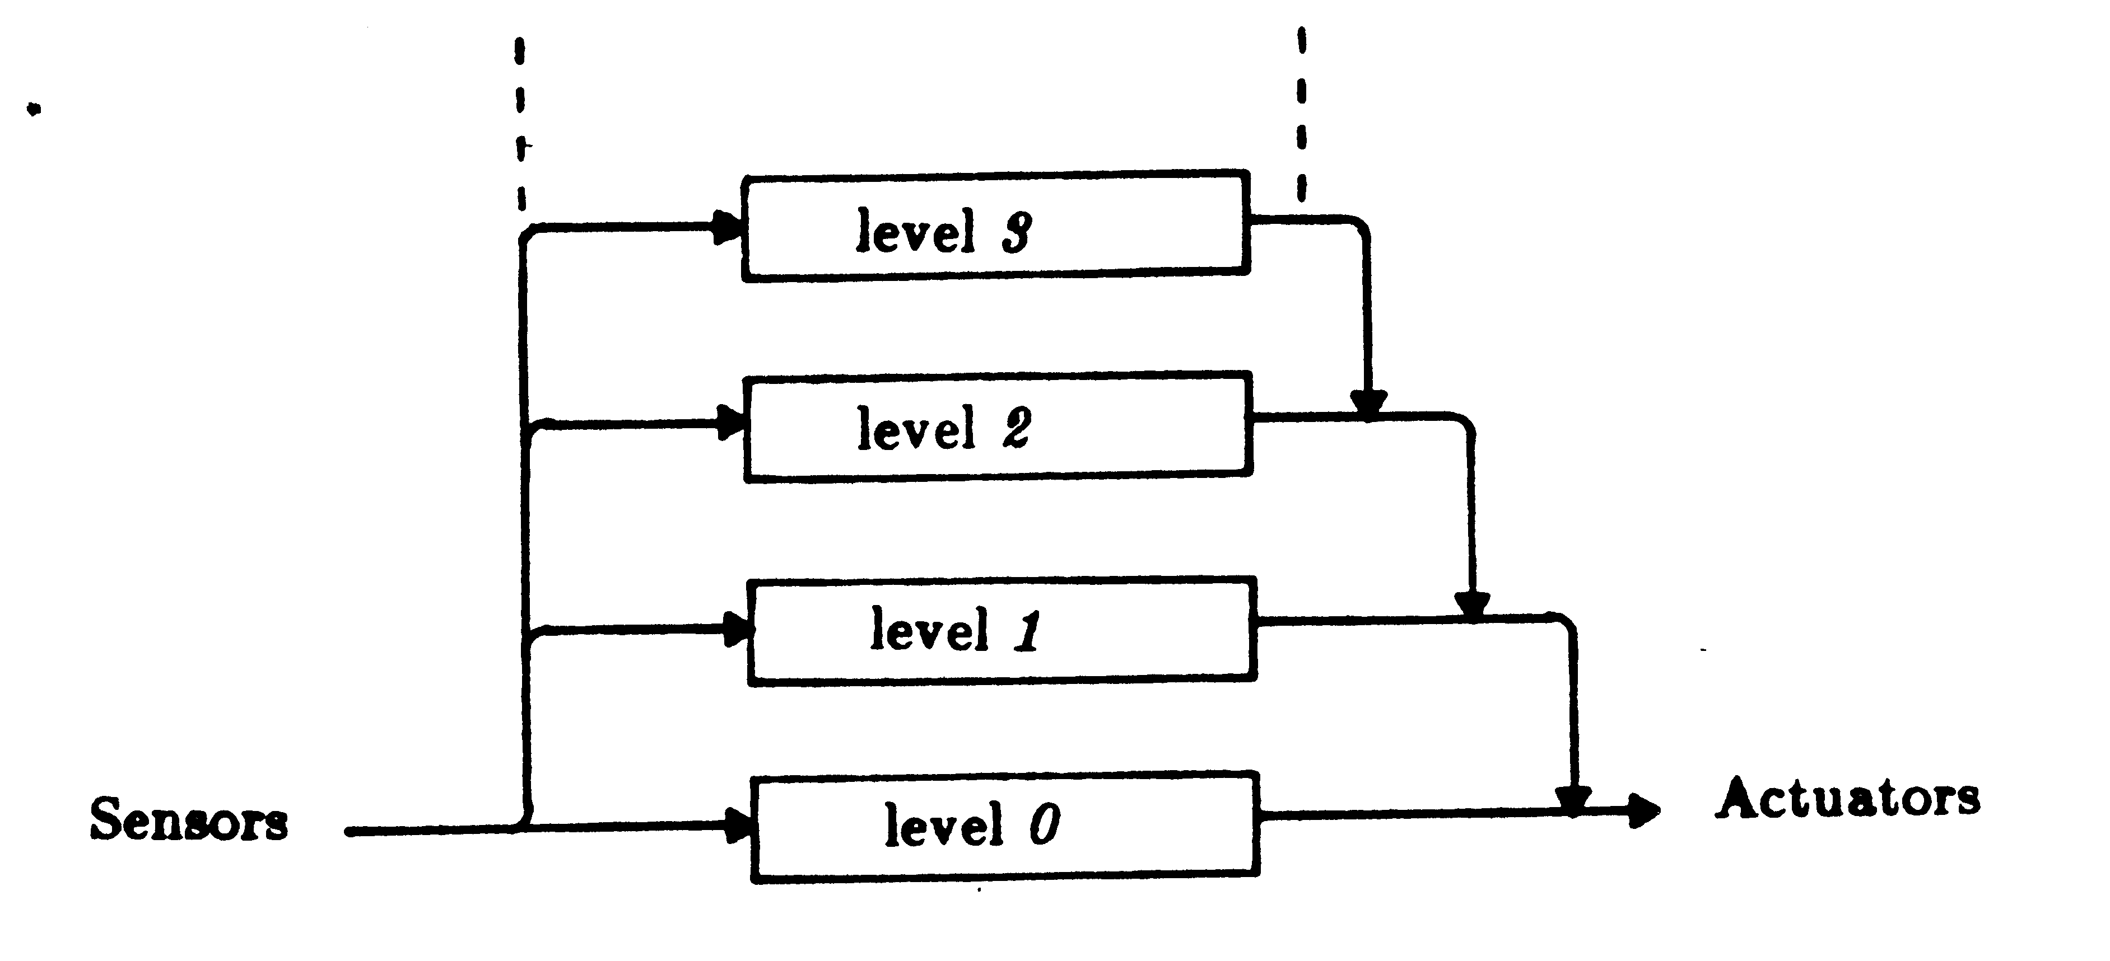
Subsumption Architecture
Notes:
Architecture must provide mechanisms for:
– Triggering behaviors
– What happens when multiple behaviors are active

Slide 18
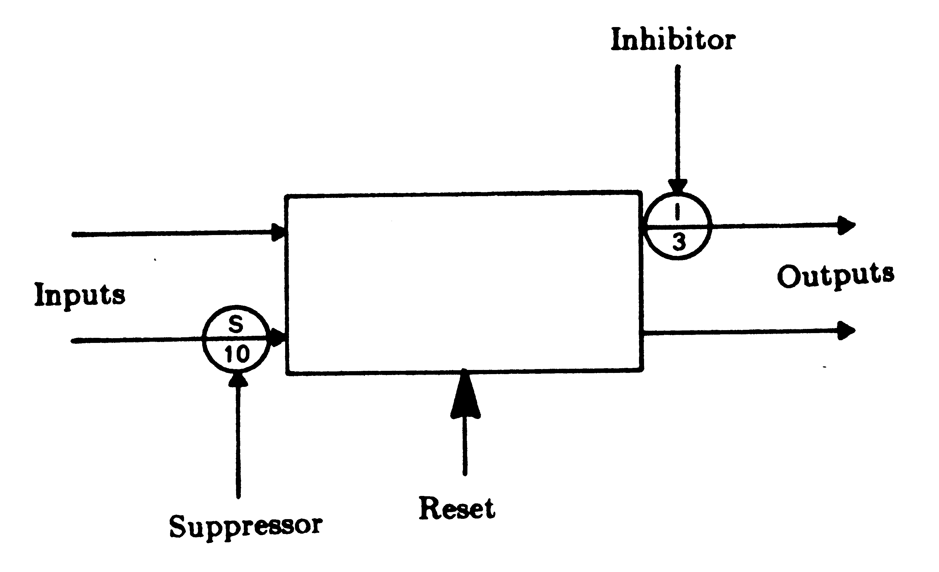
Subsumption Architecture

Slide 19
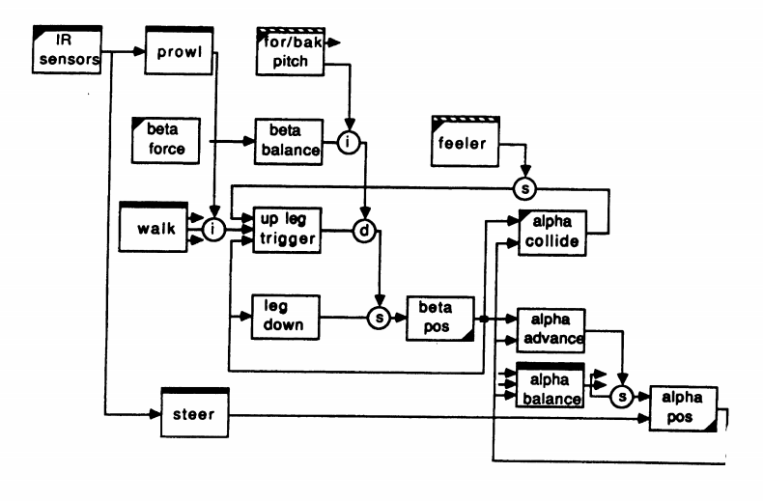
Subsumption for Genghis
Brooks, Rodney A. "A Robot That Walks; Emergent Behaviors from a Carefully Evolved Network," [pdf format], MIT AI Lab Memo 1091, February 1989.

Slide 20
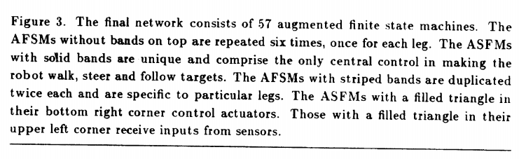
Subsumption for Genghis
Notes:
Moravec's paradox[edit]
Main article: Moravec's paradox
Moravec's paradox is the discovery by artificial intelligence and robotics researchers that, contrary to traditional assumptions, high-level reasoning requires very little computation, but low-level sensorimotor skills require enormous computational resources. The principle was articulated by Hans Moravec (whence the name) and others in the 1980s.
As Moravec writes:
Encoded in the large, highly evolved sensory and motor portions of the human brain is a billion years of experience about the nature of the world and how to survive in it. The deliberate process we call reasoning is, I believe, the thinnest veneer of human thought, effective only because it is supported by this much older and much powerful, though usually unconscious, sensorimotor knowledge. We are all prodigious olympians in perceptual and motor areas, so good that we make the difficult look easy. Abstract thought, though, is a new trick, perhaps less than 100 thousand years old. We have not yet mastered it. It is not all that intrinsically difficult; it just seems so when we do it.

Slide 21
Moravec’s Paradox
Moravec's paradox
Main article: Moravec's paradox
Moravec's paradox is the discovery by artificial intelligence and robotics researchers that, contrary to traditional assumptions, high-level reasoning requires very little computation, but low-level sensorimotor skills require enormous computational resources. The principle was articulated by Hans Moravec (whence the name) and others in the 1980s.
https://en.wikipedia.org/wiki/Moravec%27s_paradox

Slide 22
2015 DARPA Grand Challenge Video
https://www.youtube.com/watch?v=g0TaYhjpOfo

Slide 23
2006 DARPA Grand Challenge Video
https://www.youtube.com/watch?v=7a6GrKqOxeU

Slide 24
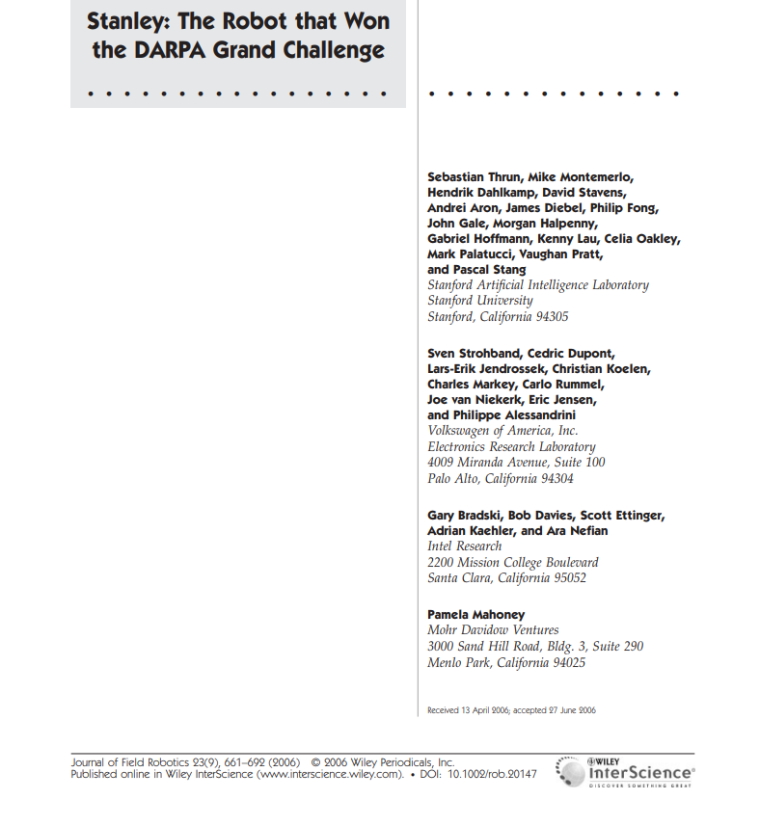

Slide 25
Hybrid, Three Layer Architecture
Reactive Layer
Tight(fast) coupling between sense/action
Executive Layer
“Glue” between Reactive and Deliberative Layer.
Integrates sensor information into a world model.
Sequences from Deliberative -> Reactive
Deliberative Layer
Generates long-view, global plans.
Develops models
Notes:
file://ads.bris.ac.uk/filestore/myfiles/Staff12/ke18164/Desktop/959013.pdf

Slide 26
Hybrid, Three Layer Architecture
Reactive Layer
Executive Layer
Deliberative Layer
Behaviour
World Model
Sense
Mission Planner
Behaviour
Behaviour
Navigator
Plan
Sense
Act
Low-Level
Controller
Pilot
Act
Sensor
Sensor
Sensor
Actuators / Effectors
(“Genghis”)
(“Shakey”)

Slide 27
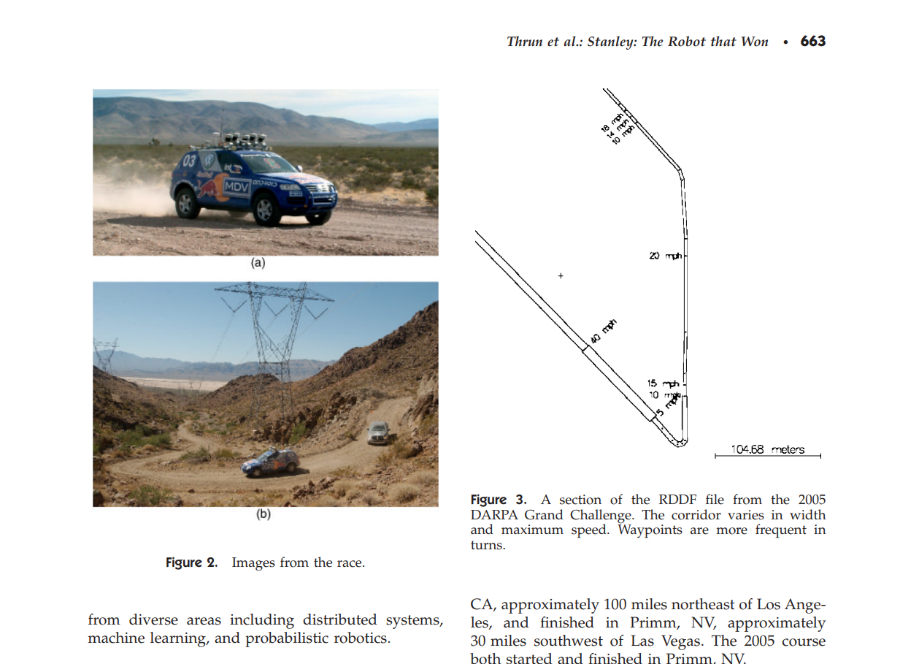

Slide 28
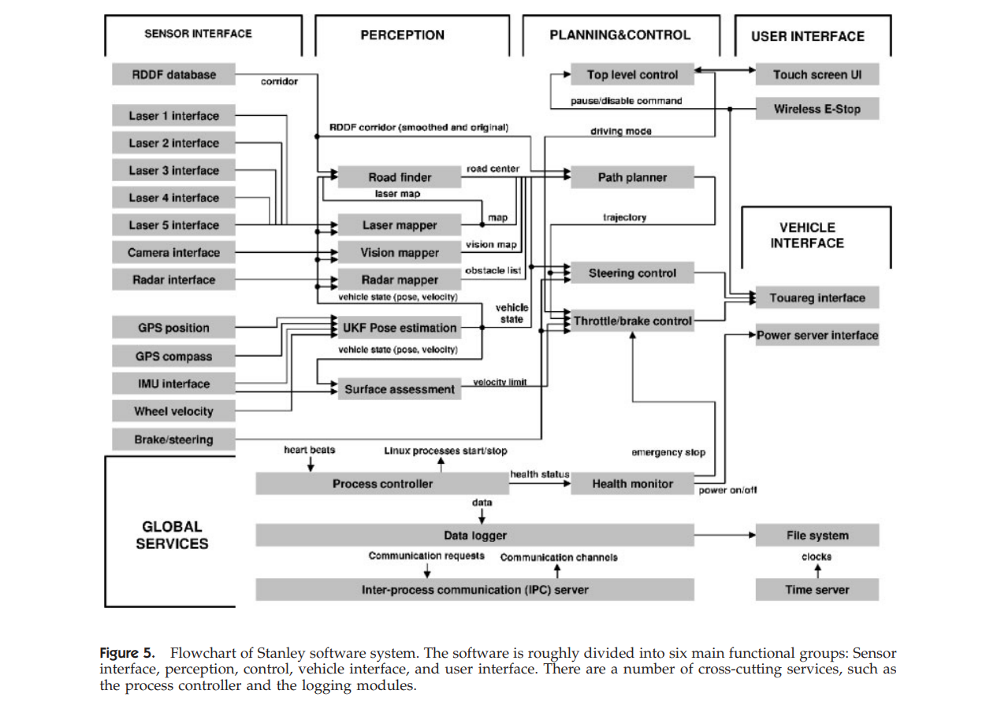

Slide 29
REACTIVE LAYER
DELIBERATIVE LAYER
EXECUTIVE LAYER

Slide 30
This Lecture:
Some Background
Automata
“Robots”
3 Architecture Paradigms
Hierarchical, Reactive, Hybrid
The Labsheets, Our Task
FSM Skeleton Code

Slide 31
The Labsheets, Our Task

Slide 32
Lab Sessions / Sheets
Week 1
Week 2
Week 3
Week 4
Week 5
Week 6
Week 7
Meet the Romi
Millis()
Encoders
PID
Line Following
Finite State Machine
Motors
Time & Speed
Kinematics
Lectures
Intro
Sensors & Actuators
Feedback Control 2
Probabilistic Robotics
System
Architectures
Path Planning
Experimental Robotics
Micro-controllers
Feedback Control 1
Kinematics
PID Drop-In
Sensor Fusion
Searching & Mapping
Toward
Assessment 2
Assessment Op 1
Assessment Op 2
Assessment Op 3

Slide 33
Millis()
Encoders
PID
Line Following
Finite State Machine
Motors
Time & Speed
Kinematics

Slide 34
Motion Control
Line Following
Go Home
PID
Line Following
Kinematics
Finite State Machine
Millis()
Encoders
Motors
Millis()
Encoders
Time & Speed
Millis()

Slide 35
Motion Control
Line Following
Go Home
PID
Line Following
Kinematics
Finite State Machine
Millis()
Encoders
Motors
Millis()
Encoders
…not as simple as one after the other
Time & Speed
which?
Millis()

Slide 36
Motion Control
Line Following
Go Home
PID
Line Following
Kinematics
Finite State Machine
Millis()
Encoders
Motors
Millis()
Encoders
Integral Error whilst waiting.
Needs a reset at the right time.
Time & Speed
Millis()

Slide 37
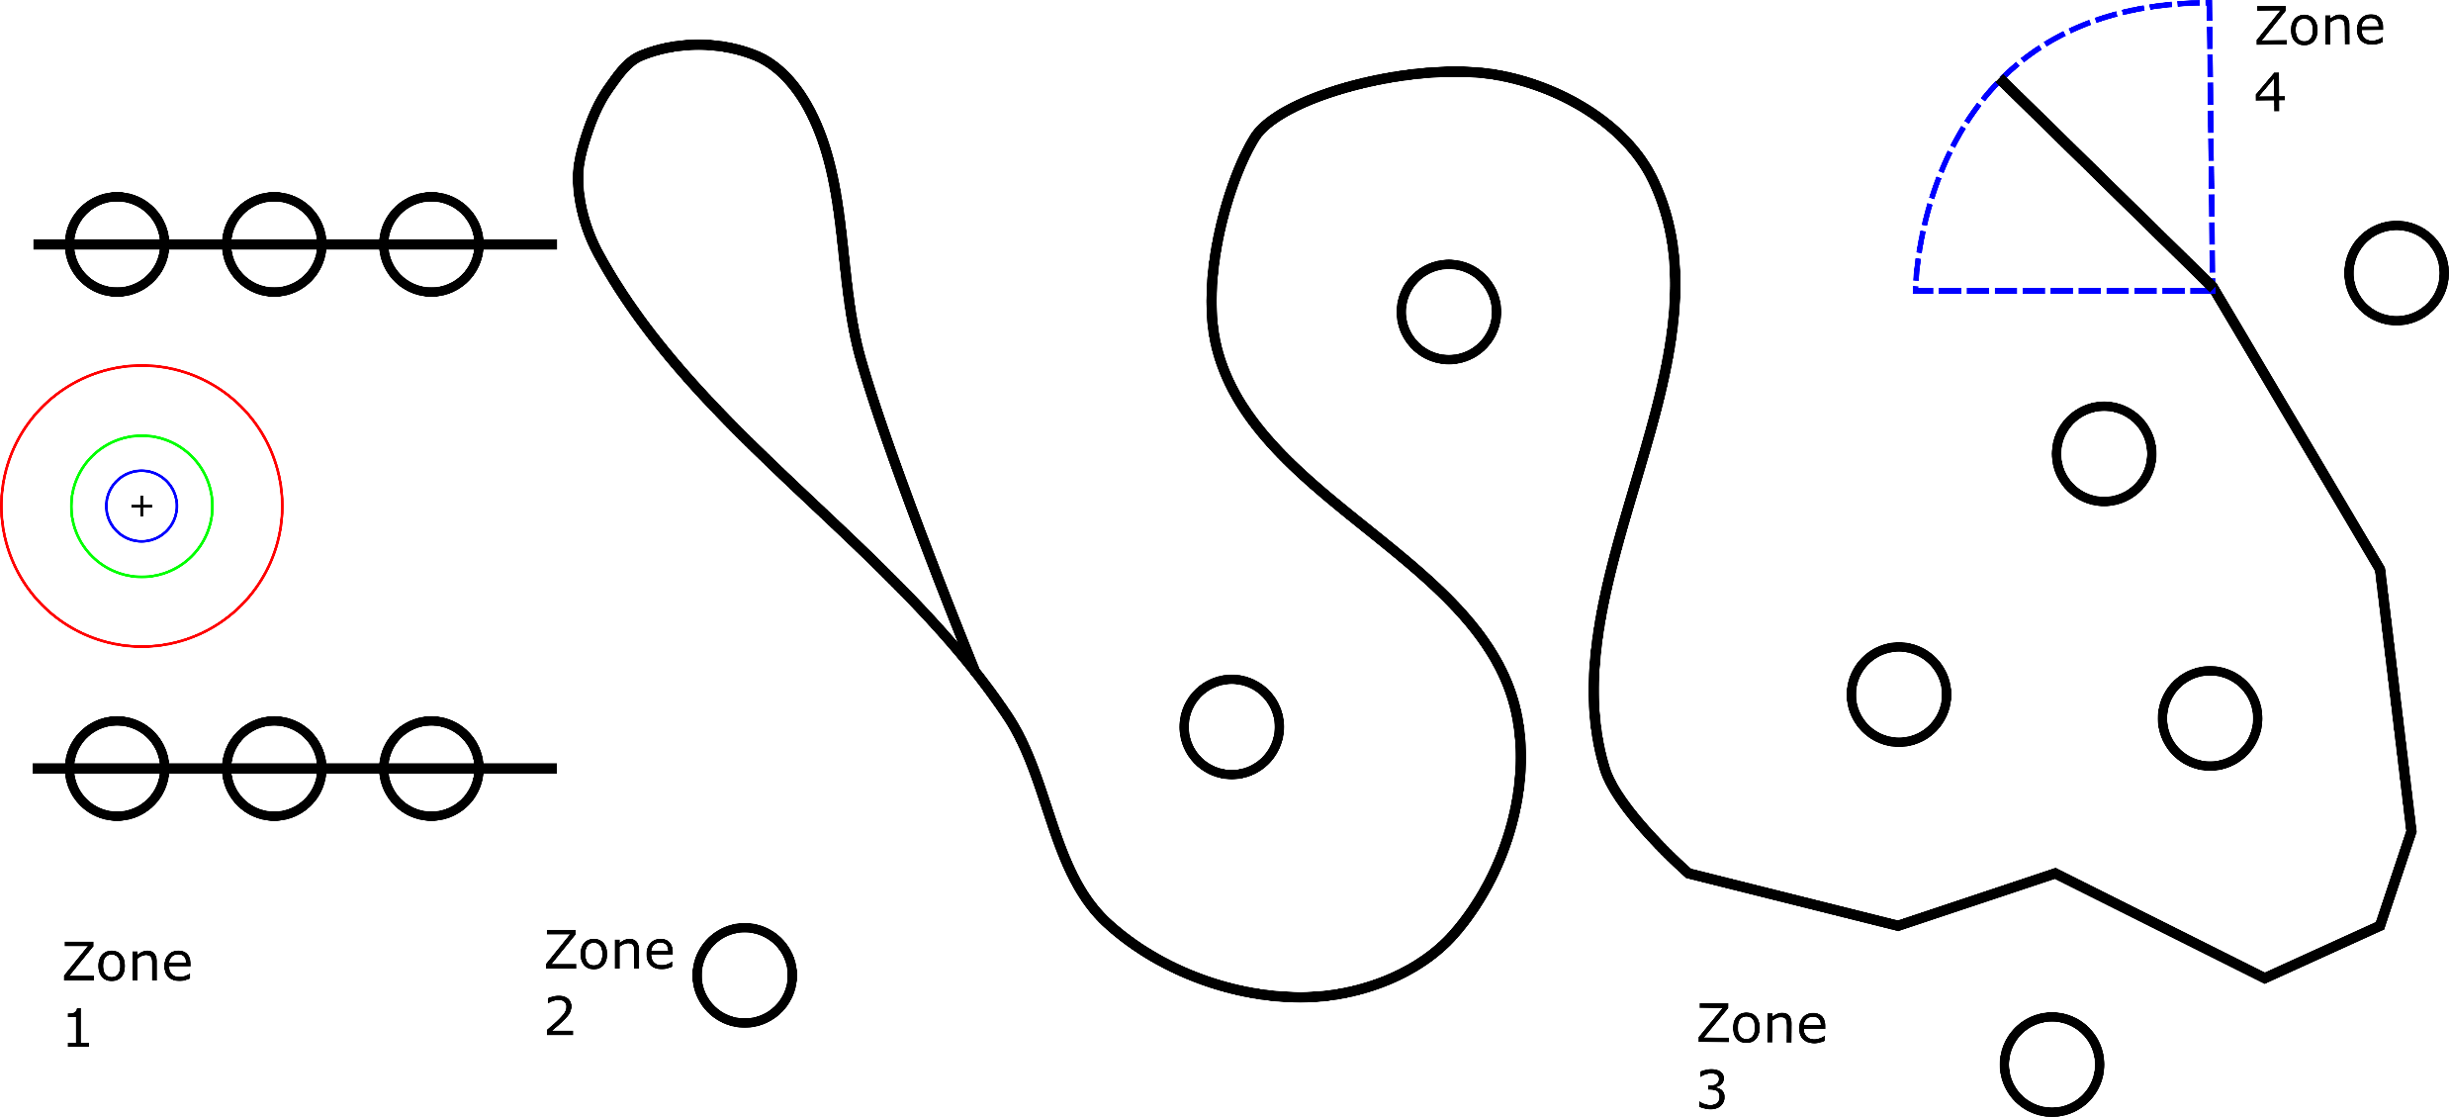
Our Task:

Slide 38
Millis()
Line Following
Motors

Slide 39
Millis()
Line Following
Line Following
Motors
Millis()
Motors

Slide 40
Millis()
Line Following
Line Following
Motors
Millis()
Motors
PID
Time & Speed
Encoders
Line Following
Motors
Millis()

Slide 41
Millis()
Line Following
Line Following
Motors
Millis()
Line Following
Motors
Millis()
Motors
PID
Time & Speed
Encoders
Line Following
Motors
Millis()

Slide 42
Millis()
Line Following
Line Following
Motors
Millis()
Line Following
Motors
Millis()
Motors
PID
Kinematics
Millis()
Encoders
Time & Speed
Motors
Encoders
PID
Time & Speed
Encoders
Line Following
Motors
Millis()

Slide 44
Power Button
Buzzer
Serial.print
FSM
Line Sensing
Motor
PID
Heading PID
Path Planner
kinematics
Encoders, Speed
ISR’s

Slide 45
Behaviours (states)

Slide 46
Behaviours (states)
Waiting
Behaviour

Slide 47
Behaviours (states)
Waiting
Behaviour
Go Forwards
(until line)

Slide 48
Behaviours (states)
Waiting
Behaviour
Go Forwards
(until line)
Follow Line 1

Slide 49
Behaviours (states)
Waiting
Behaviour
Go Forwards
(until line)
Follow Line 1
Follow Line 2

Slide 50
Behaviours (states)
Stop & Beep at Line End
Waiting
Behaviour
Go Forwards
(until line)
Follow Line 1
Follow Line 2

Slide 51
Behaviours (states)
<< Go Home
Stop & Beep at Line End
Waiting
Behaviour
Go Forwards
(until line)
Follow Line 1
Follow Line 2

Slide 52
Waiting
Behaviour
Go Forwards
(until line)
Follow Line 1
Follow Line 2
Stop & Beep at Line End
<< Go Home

Slide 53
Waiting
Behaviour
Go Forwards
(until line)
Elapsed Time
Delay
Button Press
Follow Line 1
Follow Line 2
Stop & Beep at Line End
<< Go Home

Slide 54
Waiting
Behaviour
Line Detected
Go Forwards
(until line)
Elapsed Time
Delay
Button Press
Follow Line 1
Follow Line 2
Stop & Beep at Line End
<< Go Home

Slide 55
Waiting
Behaviour
Line Detected
Go Forwards
(until line)
Elapsed Time
Delay
Button Press
Follow Line 1
Follow Line 2
Search For Line
Backtrack
Line Lost
Stop & Beep at Line End
<< Go Home

Slide 56
Waiting
Behaviour
Line Detected
Go Forwards
(until line)
Elapsed Time
Delay
Button Press
Line Complexity
Time
Follow Line 1
Follow Line 2
Search For Line
Backtrack
Line Lost
Stop & Beep at Line End
<< Go Home

Slide 57
Waiting
Behaviour
Line Detected
Go Forwards
(until line)
Elapsed Time
Delay
Button Press
Line Complexity
Time
Follow Line 1
Follow Line 2
Search For Line
Backtrack
Line Lost
Stop & Beep at Line End
<< Go Home

Slide 58
Waiting
Behaviour
Line Detected
Go Forwards
(until line)
Elapsed Time
Delay
Button Press
Line Complexity
Time
Follow Line 1
Travel Distance
Time
Confidence
Follow Line 2
Search For Line
Backtrack
Line Lost
Stop & Beep at Line End
<< Go Home

Slide 59
Waiting
Behaviour
Line Detected
Go Forwards
(until line)
Elapsed Time
Delay
Button Press
Line Complexity
Time
Follow Line 1
Travel Distance
Time
Confidence
Follow Line 2
Search For Line
Backtrack
Line Lost
?
Stop & Beep at Line End
<< Go Home

Slide 60
Waiting
Behaviour
Line Detected
Go Forwards
(until line)
Elapsed Time
Delay
Button Press
Line Complexity
Time
Follow Line 1
Travel Distance
Time
Confidence
Follow Line 2
Search For Line
Backtrack
Line Lost
?
Stop & Beep at Line End
X == 0
Y == 0
<< Go Home
Stop, Beep

Slide 61
Waiting
Behaviour
Line Detected
Go Forwards
(until line)
Elapsed Time
Delay
Button Press
Line Complexity
Time
Follow Line 1
Travel Distance
Time
Confidence
Reset PID
Follow Line 2
Search For Line
Backtrack
Line Lost
Stop & Beep at Line End
X == 0
Y == 0
<< Go Home
Stop, Beep

Slide 62
Waiting
Behaviour
Elapsed Time
Delay
Button Press
Line Detected
Go Forwards
(until line)
Line Complexity
Time
Reset PID
Follow Line 1
Travel Distance
Time
Confidence
Reset PID
Follow Line 2
Search For Line
Backtrack
Line Lost
Stop & Beep at Line End
X == 0
Y == 0
<< Go Home
Stop, Beep

Slide 63
This Lecture:
Some Background
Automata
“Robots”
3 Architecture Paradigms
Hierarchical, Reactive, Hybrid
The Labsheets, Our Task
FSM Skeleton Code

Slide 64
FSM Skeleton Code

Slide 65
You current programs?
void setup() {
…
}
void loop() {
behaviour0();
}
void behaviour0() {
…
}

Slide 66
void setup() {
…
}
int STATE = 0;
void loop() {
switch( STATE ) {
case 0: behaviour0();
break;
case 1: behaviour1();
break;
case 2: behaviour2();
break;
}
}
void behaviour0() {
…
}
void behaviour1() {
…
}
void behaviour2() {
…
}

Slide 67
void setup() {
…
}
int STATE = ?;
void loop() {
switch( STATE ) {
case 0: behaviour0();
break;
case 1: behaviour1();
break;
case 2: behaviour2();
break;
}
}
void behaviour0() {
// Sensing, info processing
…
if( sensing == correct ) {
// robot behaviour code
…
} else if( sensing != correct ) {
// transition code.
// any tidy up, and then…
STATE = next_state;
}
}
void behaviour1() {
…
}
void behaviour2() {
…
}

Slide 68
void setup() {
…
}
int STATE = ?;
void loop() {
switch( STATE ) {
case 0: behaviour0();
break;
case 1: behaviour1();
break;
case 2: behaviour2();
break;
}
}
void behaviour0() {
// Sensing, info processing
…
if( state_info == correct ) {
// robot behaviour code
…
} else if( state_info != correct ) {
// transition code.
// any tidy up, and then…
STATE = next_state;
}
}
void behaviour1() {
…
}
State Behaviour
void behaviour2() {
…
}
State Transition

Slide 69
void setup() {
…
}
int STATE = ?;
void loop() {
switch( STATE ) {
case 0: behaviour0();
break;
case 1: behaviour1();
break;
case 2: behaviour2();
break;
}
}
ISR( encoder0 )() {
…
}
void behaviour0() {
…
}
void behaviour1() {
…
}
ISR( encoder1 )() {
…
}
void behaviour2() {
…
}
ISR( timer3 )() {
…
}

Slide 70
void setup() {
…
}
int STATE = ?;
kinematics romi_pose;
PID l_motor_pid;
PID r_motor_pid;
LineSensor line_sensor;
…
void loop() {
switch( STATE ) {
case 0: behaviour0();
break;
case 1: behaviour1();
break;
case 2: behaviour2();
break;
}
}
ISR( encoder0 )() {
…
}
void behaviour0() {
…
}
void behaviour1() {
…
}
ISR( encoder1 )() {
…
}
void behaviour2() {
…
}
ISR( timer3 )() {
…
}

Slide 71
void setup() {
…
}
int STATE = ?;
kinematics romi_pose;
PID l_motor_pid;
PID r_motor_pid;
LineSensor line_sensor;
…
void resetPID() {
if( state == changed )
}
void loop() {
switch( STATE ) {
case 0: behaviour0();
break;
case 1: behaviour1();
break;
case 2: behaviour2();
break;
}
}
ISR( encoder0 )() {
…
}
void behaviour0() {
…
}
void behaviour1() {
…
}
ISR( encoder1 )() {
…
}
void behaviour2() {
…
}
ISR( timer3 )() {
…
}

Slide 72
This Lecture:
Some Background
Automata
“Robots”
3 Architecture Paradigms
Hierarchical, Reactive, Hybrid
The Labsheets, Our Task
FSM Skeleton Code

